Slide 1
Corporate Briefing Session
November 20,2019

Slide 2
Brief Overview
SANA INDUSTRIES LIMITED was established by Sanaulla family in 1988 for manufacturing of man-made blended Fibre Yarns and became a member of Karachi Stock Exchange in 1989.
Sana Industries is a well known brand in Yarn Market of Pakistan. Initially it started with the capacity of 12,000 spindles and now its capacity is 32,052 spindles. It innovates rapidly into new products and due to this caters to customers in top and best category in the Fabric Manufacturing segment in Pakistan.
In the year 2006 Sana Industries expanded and diversified its business activities by entering into a new line of business i.e. "Temperature controlled warehouse management".
It was the first International standard temperature controlled warehouse of Pakistan which had Hazard free refrigeration system.
In April 2017, the Company had branched out its Cold Storage business to its subsidiary “Sana Logistics (Private) Limited”, and currently holds 70% of the total holdings of Sana Logistics (Private) Limited.

Slide 3
Company Insights
The company has consolidated in the past years and is ready for an aggressive expansion in future.
Unit 1:
Installed in 1988.
Upgraded between 2003 to 2006.
Capacity – 20,500 spindles
Unit 2:
Installed in 1992.
Upgraded between 2016 to 2018.
Capacity – 11,500 spindles

Slide 4
Management Information
Board of Directors
H.R. & Remuneration Committee
Mr. Mohammed Younus Nawab | Chairman
Mr. Ibrahim Younus | Director
Mr. Ismail Younus | Director
Mr. Muhammad Faizanullah | Director
Mr. Mohammad Ashfaq | Director
Mr. Mohammed Khalid Yousuf | Director
Hafiz Mohammed Irfan Nawab | Chief Executive
Mr. Mohammed Khalid Yousuf | Chairman
Mr. Mohammad Ashfaq | Member
Mr. Ibrahim Younus | Member
Audit Committee
C.F.O. / Company Secretary
Mr. Mohammed Khalid Yousuf | Chairman
Mr. Mohammad Ashfaq | Member
Mr. Abdul Hameed | Member
Mr. Muhammad Faizanullah | Member & Secretary
Mr. Abdul Hussain Antaria

Slide 5
Types of Textile Fibres
Cotton Fibres
Specialty Natural Fibres
Synthetic Fibres
Artificial Fibres (Naturally Derived)
Flax (Linen), Bamboos, etc
Polyester & Acrylic
Viscose, Lyocell & Modal
Customized Yarns

Slide 6
Technology
Ring Spinning
Rotor Spinning
Vortex Air Jet Spinning
Traditional and most common technology
Possible future prospects
One of the pioneers in synthetic (non – cotton) ring spinning

Slide 7
Customers Profile
Yarn Customers
Knitters
Weavers
Sewing Thread Manufacturers
Home Textile
Clothing
Local Sewing Thread Supplies
Suppliers to Bulk Garment Factories
Men’s Fashion Clothing
Women’s Fashion Clothing

Slide 8
Economy
6 Month KIBOR
PKR/USD
GDP Composition
GDP Growth

Slide 9
Financial Highlights
(PKR Million) | FY19 | FY18 | FY17 | FY16 | FY15 | FY14
Turnover | 2,402.53 | 2,028.80 | 1,728.18 | 1,791.12 | 1,695.87 | 1,382.87
Gross profit | 309.69 | 177.83 | 53.21 | 177.37 | 226.74 | 176.22
Profit / (Loss) after tax | 108.02 | 11.03 | (36.23) | 64.74 | 89.56 | 79.77
Total Assets | 1,422.95 | 1,306.37 | 1,197.15 | 1,087.97 | 985.59 | 899.36
Earning per share | 11.17 | 0.80 | (4.07) | 7.53 | 10.42 | 9.28

Slide 10
Financial Snapshot
Balance Sheet (PKR Mn) Consolidated | FY’19 | FY’18 | % YoY.
Non-current Assets | 624.39 | 667.24 | -6%
Current Assets | 798.56 | 639.13 | 25%
Total Assets | 1,422.95 | 1,306.37 | 9%
Authorized Capital | 100.00 | 100.00 | -
Issued, subscribed and paid-up capital | 85.94 | 85.94 | -
Non controlling interest | 29.92 | 17.89 | 67%
Total equity | 406.80 | 329.25 | 24%
Non-current Liabilities | 181.20 | 227.34 | -20%
Current-Liabilities | 834.96 | 749.78 | 11%
Total Equities & Liabilities | 1,422.95 | 1,306.37 | 9%

Slide 11
Business Review
P&L (PKR Mn) Consolidated | FY’19 | FY’18 | % YoY.
Net sales | 2,402.53 | 2,028.80 | 18%
COGS | 2,092.85 | 1,850.97 | 13%
Gross Profit | 309.69 | 177.83 | 74%
Operating profit | 216.45 | 120.03 | 80%
Finance costs | 77.34 | 55.35 | 40%
Profit before taxation | 139.12 | 64.68 | N/A
Taxation | 31.10 | 53.66 | -42%
Profit after taxation | 108.02 | 11.03 | N/A
Non - controlling interest | 12.03 | 4.16 | N/A
EPS | 11.17 | 0.80 | N/A

Slide 12
Business Review

Slide 13
Business Review

Slide 14
Business Review
Cash & Bonus Dividend History
Year | Cash Dividend | Bonus
2009 | 3.5 | -
2010 | 6.00 | -
2011 | 7.5 | 25%
2012 | 6.5 | -
2013 | 5.00 | 25%
2014 | 7.50 | -
2015 | 8.00 | -
2016 | 3.50 | -
2017 | - | -
2018 | 2.00 | -
2019 | 2.50 | -

Slide 15
Awards & Recognition
We have been awarded TOP COMPANIES AWARDS of Karachi Stock Exchange for the years 1991, 1992, 1994 and 1995 for exemplary performance and commendable distribution to the share holders

Slide 16
Sana Logistics Pvt. Ltd

Slide 17
About us
Sana logistics (Private) Limited is the subsidiary of Sana Industries Limited ( Sana Group). Engaged in business activities of textile manufacturing we diversified in setting up state of the art designed Cold chain logistics distribution center in 2006.
Our Flagship facility which started of with 2000 pallets spots stands at 22,000 pallet spots till to date. Our reputation is founded on developing intelligent and tailor-made solutions for our diversified blue-chip customers by leveraging processes, people, technology and infrastructure, and the strength of our strategic partnerships and alliances with leading technology partners.”
Services we offer
Temperature Control Warehousing services
Ambient Warehousing Service
Cross Docking Service
Inventory Management
Plugin Points For Refer Vans
Value added services
Transportation cross the nation

Slide 18
Mission Statement & Vision
To deliver excellence in end-to-end logistics and supply chain management, daily – enabling customers to grow in an efficient, proactive and cost effective manner
At SANA, ‘fast moving, forward thinking’ describes our vision to succeed – to be a leading, integrated logistics and supply chain management company that operates in the context of a global economy. The SANA brand is committed to quality service, people development and excellence. We aim to demonstrate and live by a performance-driven culture, communicate transparently and exhibit a strong heritage of social responsibility.

Slide 19
Excellence in Operations
Derivatives | Karachi Warehouse | Hub Warehouse | NHW WH(R)
Started operations | Year 2006 | Year 2008 | Year 2017-18
Land Size | 10 Acers | 2 Acers | 2.5 Acers
Storage Capacity | 22,000 Pallets | 1,500 Pallets | 8,500 Pallets
Loading Docks | 35 | 03 | 10
Expansion provision | 15,000 Pallets | 10,000 Pallets | 2,000 Pallets
Expansion of Loading Docks | 15 | 10 | 04
Daily Managing loading and offloading of vehicles | +100 vehicles | 5 vehicles | +40 Vehicles
Average Number of cases inward monthly | +850,000 cases | 25,000 cases | +700,000 cases
Average number of cases outward monthly | +850,000 cases | 25,000 cases | +700,000 cases

Slide 20
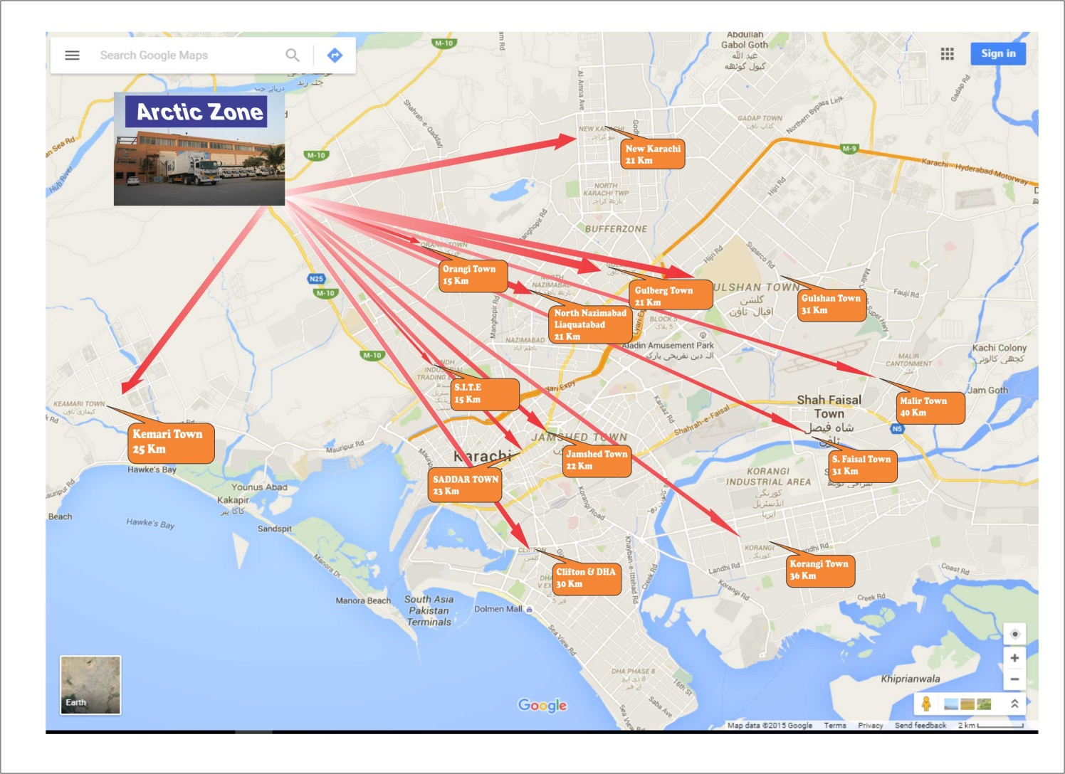
Strategic Location

Slide 21
Our Valued Customers

Slide 22
Scope of Services
Complete management of warehouse
Loading and Offloading Stock at the warehouse
Picking, put away, staging, quality check, dispatching, receiving
Inventory management & traceability
Record keeping
Quality Management
Pest Control
Inventory reports

Slide 23
Future Outlook
The management has a neutral to positive view of the future, if the local tax system is made easier and accepted by the masses, business will shift towards the organized sector and this will beneficial for Company.
The company is planning to expand its production capacity by ~15%, which will be finalized by next year.
The management is also considering to diversify its product portfolio.

Slide 24
Thank You
Q&A

